Slide 1

Analysis of World University Ranking Milee Singh Ashawad milee@bu.edu

Slide 2
Times Higher Education Dataset
Data Source: Times Higher Education University Ranking
Computed between year 2011-2016
Dataset contains around 2603 observation.
https://www.timeshighereducation.com/world-university-rankings

Slide 3
Attributes
Attributes | Description
world_rank | World rank for university
Univ_name | Name of university
teaching | University score for teaching
research | University score for research
total_score | Total score for university
num_students | Number of students at the university
International_student | Percentage of the students who are international
year | Year of ranking(2011-2016)
country | Country of each university

Slide 4
Pre-Processing
Removed the observation which contains null value
Changed the name of the countries which were having similar name
Converted data from SQLite in .Csv format
Imported data in the R
Saved the data in .Rdata format

Slide 5
Facts About Dataset
Year | No. of Students | No. of Universities
2011 | 4,688,578 | 194
2012 | 9,219,390 | 387
2013 | 9,259,483 | 389
2014 | 9,188,463 | 391
2015 | 9,219,045 | 390
2016 | 19,159,883 | 793

Slide 6
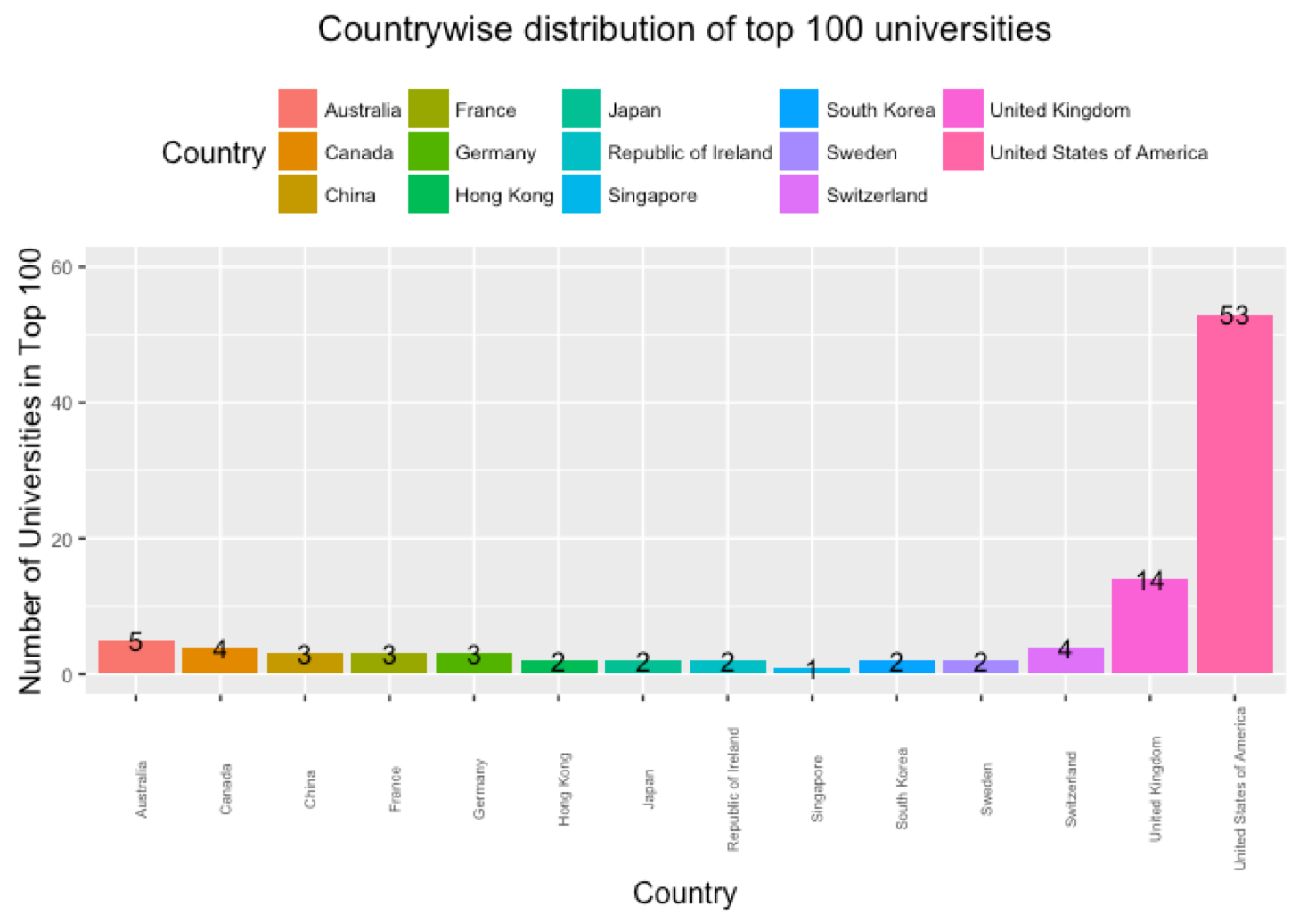
Distribution of Top 100 Universities

Slide 7
Distribution of Top 100 Universities
Highest: United States of America has 53 of top 100 universities
Lowest: Singapore has 1 of top 100 universities
United Kingdom has 14 of top 100 universities

Slide 8
Distribution between Rank and Score

Slide 9
Distribution between Rank and Score
Harvard University has rank 1 and score of 96.1
Carnegie Mellon University has rank 20 and score of 79.3
University of Toronto has rank 17 and score of 82

Slide 10
Research Score of United States

Slide 11
Research Score of United States
Research Mean Score was declining from 2011 to 2016
The lowest research Mean Score in 2016

Slide 12
Teaching in 2015

Slide 13
Teaching in 2016

Slide 14
Comparison of Teaching Score

Slide 15
Research Score Comparison

Slide 16
Research Score Comparison
Research score is gradually increased for USA
For year 2016, the density of UK is smaller than USA
There is a gradual fall seen in UK

Slide 17
Score of Top 3 Universities

Slide 18
Ivy League Ranking

Slide 19
Boston University Ranking

Slide 20
Boston University Ranking
The rank was constant for year 2012 and 2013
Boston University ranked 50th in the year 2014
It has 64th rank in year 2016 and is the lowest of all year.

Slide 21
International Students in USA

Slide 22
Central Limit Theorem
Central Limit Theorem was applied on the total_score
Central Limit Theorem got applicable when sample_size was set to 100 and generated using the Simple Sampling method

Slide 23
Central Limit Theorem

Slide 24
Central Limit Theorem Analysis
Sample Size | Mean | Standard Deviation
100 | 160.4886 | 10.19679
200 | 160.7876 | 7.391006
300 | 160.7812 | 6.103502
400 | 160.9911 | 5.209769
The mean remains constant and as the sample size is increased, the standard deviation of the sample decreases

Slide 25
Simple Sampling

Slide 26
Systematic Sampling

Slide 27
Cluster Sampling

Slide 28
Thank You Milee Singh Ashawad

